Slide 1
Linear regression: categorical variables
Notes:
In this video, I will introduce a few important basic concepts underlying probability theories

Slide 2


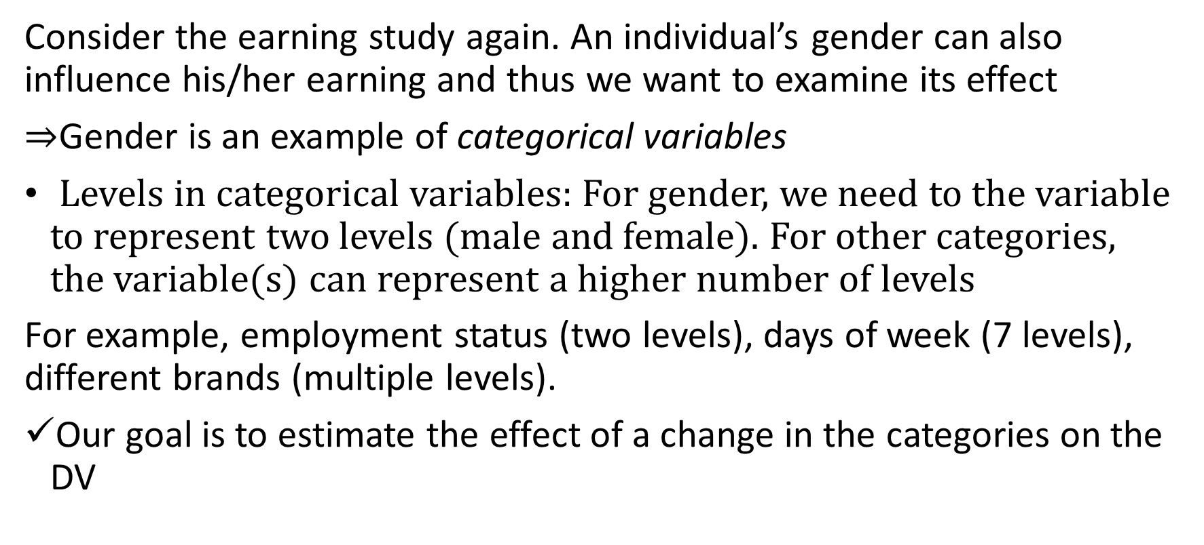
Categorical variables as IVs
DV
(health)
Consider the earning study again. An individual’s gender can also influence his/her earning and thus we want to examine its effect
$⇒$Gender is an example of categorical variables
Levels in categorical variables: For gender, we need to the variable to represent two levels (male and female). For other categories, the variable(s) can represent a higher number of levels
For example, employment status (two levels), days of week (7 levels), different brands (multiple levels).
Our goal is to estimate the effect of a change in the categories on the DV

Slide 3
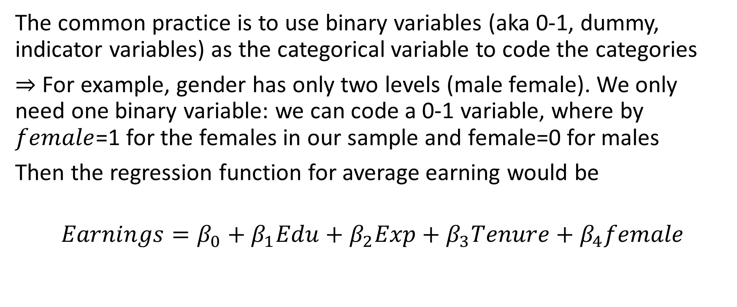
Coding a categorical variable
The common practice is to use binary variables (aka 0-1, dummy, indicator variables) as the categorical variable to code the categories
$⇒$ For example, gender has only two levels (male female). We only need one binary variable: we can code a 0-1 variable, where by $female$=1 for the females in our sample and female=0 for males
Then the regression function for average earning would be
$$Earnings=β_{0}+β_{1}Edu+β_{2}Exp+β_{3}Tenure+β_{4}female$$

Slide 4
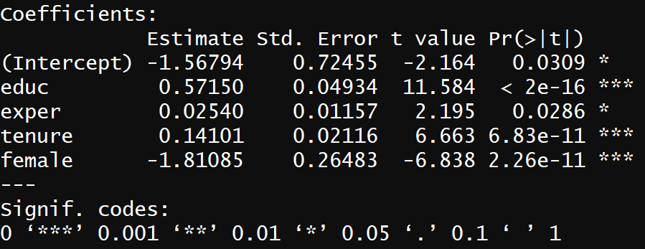
# use wage1 from Wooldridge. DV is hourly earning
>library(wooldridge)
# check out the categorial variable first;
> View(wage1$female)
>reg.results.wage1 <-lm(wage ~ educ + exper + tenure + female, data= wage1)
>summary(reg.results.wage1)

Slide 5
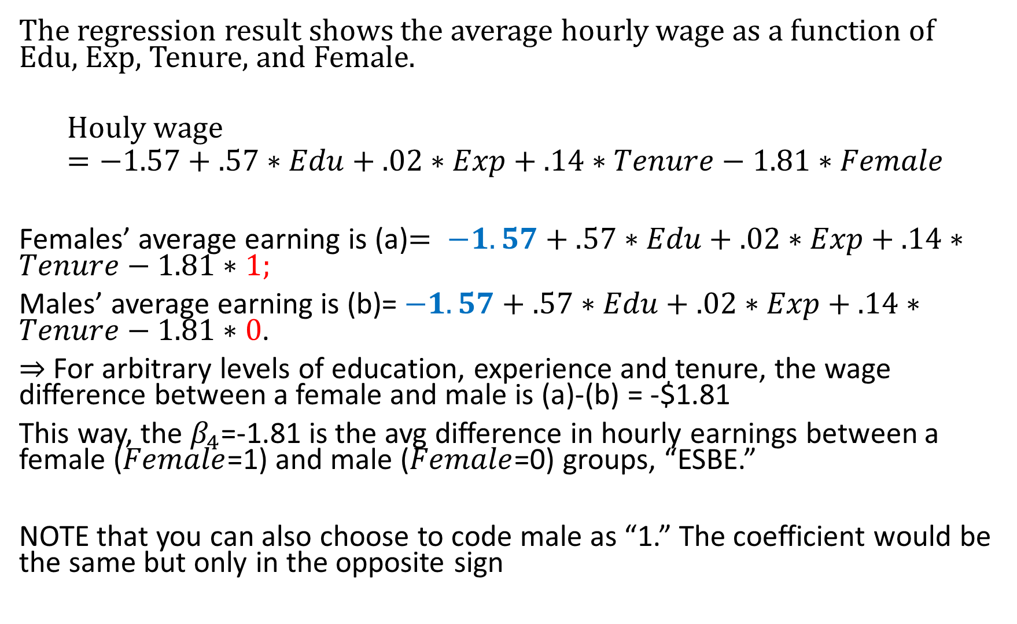
The regression result shows the average hourly wage as a function of Edu, Exp, Tenure, and Female.
$$Houly wage=−1.57+.57∗Edu+.02∗Exp+.14∗Tenure−1.81∗Female$$
Females’ average earning is (a)$= −1.57+.57∗Edu+.02∗Exp+.14∗Tenure−1.81∗1;$
Males’ average earning is (b)=$−1.57+.57∗Edu+.02∗Exp+.14∗Tenure−1.81∗0$.
$⇒$ For arbitrary levels of education, experience and tenure, the wage difference between a female and male is (a)-(b) = -$1.81
This way, the $β_{4}$=-1.81 is the avg difference in hourly earnings between a female ($Female$=1) and male ($Female$=0) groups, “ESBE.”
NOTE that you can also choose to code male as “1.” The coefficient would be the same but only in the opposite sign

Slide 6
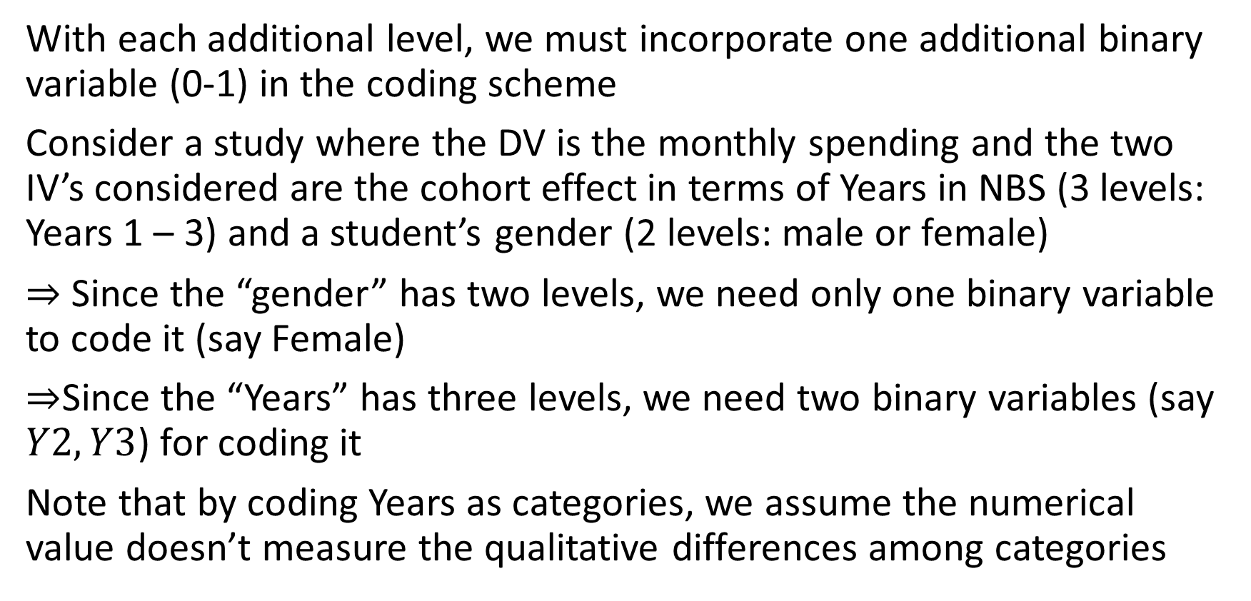
Categorical variables with more than 2 levels
With each additional level, we must incorporate one additional binary variable (0-1) in the coding scheme
Consider a study where the DV is the monthly spending and the two IV’s considered are the cohort effect in terms of Years in NBS (3 levels: Years 1 – 3) and a student’s gender (2 levels: male or female)
$⇒$ Since the “gender” has two levels, we need only one binary variable to code it (say Female)
$⇒$Since the “Years” has three levels, we need two binary variables (say $Y2,Y3$) for coding it
Note that by coding Years as categories, we assume the numerical value doesn’t measure the qualitative differences among categories

Slide 7
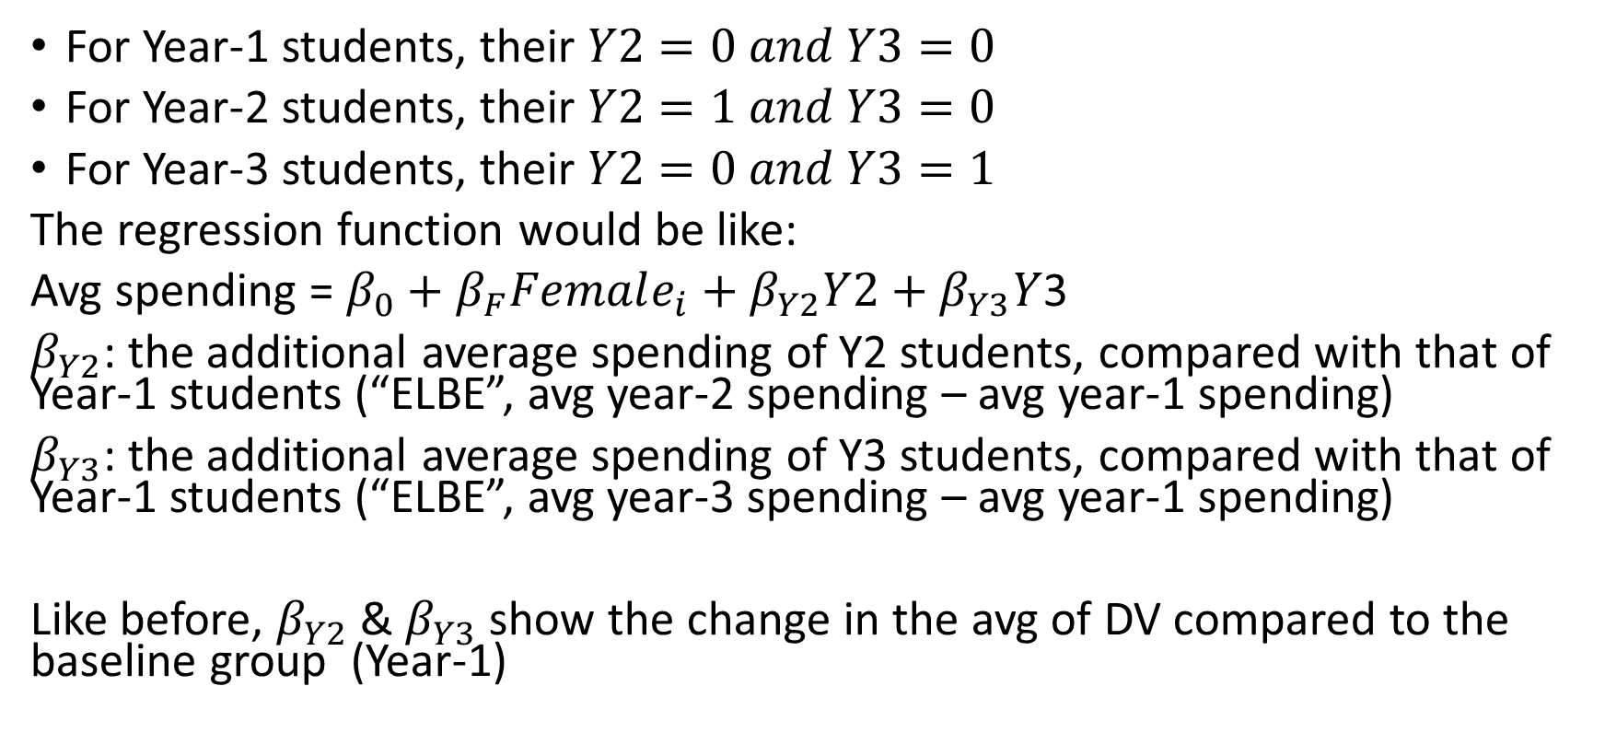
Example: coding a three-level categorical variable
For Year-1 students, their $Y2=0 and Y3=0$
For Year-2 students, their $Y2=1 and Y3=0$
For Year-3 students, their $Y2=0 and Y3=1$
The regression function would be like:
Avg spending = $β_{0}+β_{F}Female_{i}+β_{Y2}Y2+$ $β_{Y3}Y$3
$β_{Y2}$: the additional average spending of Y2 students, compared with that of Year-1 students (“ELBE”, avg year-2 spending – avg year-1 spending)
$β_{Y3}$: the additional average spending of Y3 students, compared with that of Year-1 students (“ELBE”, avg year-3 spending – avg year-1 spending)
Like before, $β_{Y2}$ & $β_{Y3}$ show the change in the avg of DV compared to the baseline group (Year-1)

Slide 8
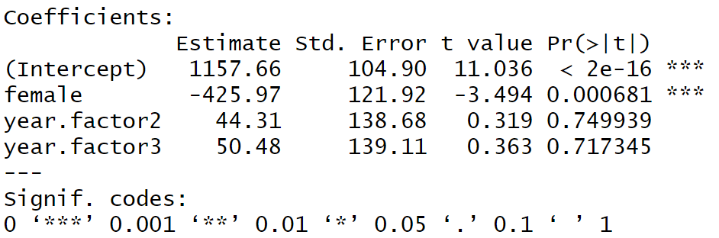
# Load the fake data called “student_spending.csv”
> fake_data=read.csv(file.choose(),header = T)
# convert “year” from a regular type of variable to a factor type
> fake_data$year.factor = factor(fake_data$year)
> reg_cat = lm(spending~female+ year.factor data= fake_data)
> summary(reg_cat)
Year is treated as a categorical variable. Thus, the interpretation is: “Y2 students’ avg monthly spending is $44.31 higher than that of Y1 students,” “Y3 students…..$50.48 higher than Y1 students.
Your justification is that a group in the analysis represents one specific (qualitative) situation

Slide 9
# Load the fake data called “student_spending.csv”
> fake_data=read.csv(file.choose(),header = T)
# convert “year” from a regular type of variable to a factor type
> fake_data$year.factor = factor(fake_data$year)
> reg_cat = lm(spending~female+ year.factor, data= fake_data)
> summary(reg_cat)
Year is treated as a categorical variable. Thus, the interpretation is: “Y2 students’ avg monthly spending is $44.31 higher than that of Y1 students (ELBE),” “Y3 students…..$50.48 higher than that of Y1 students (ELBE).”
Your justification should be that a group in the analysis represents one specific (qualitative) situation

Slide 10



Years as categories
Year 1
Year 2
Year 3

Slide 11
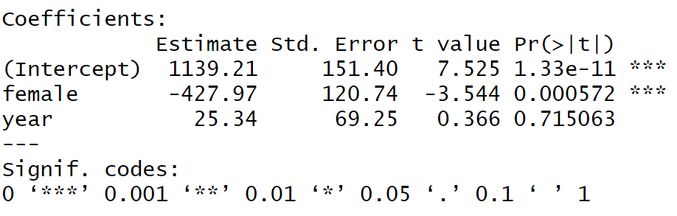
# Load the fake data called “student_spending.csv”
> fake_data=read.csv(file.choose(),header = T)
> reg_continuous = lm(spending~female+year,data= fake_data)
> summary(reg_continuous)
Year is treated as a continuous variable. Thus, the interpretation is: “with each additional year in the program, a student’s avg monthly spending will increase by $25.34 (ELBE).”
Your justification is that Year in the analysis represents some kind of cumulated effects in the program

Slide 12
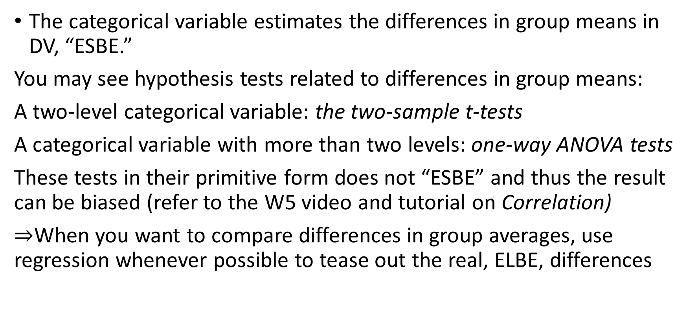
Bibliographical notes
The categorical variable estimates the differences in group means in DV, “ESBE.”
You may see hypothesis tests related to differences in group means:
A two-level categorical variable: the two-sample t-tests
A categorical variable with more than two levels: one-way ANOVA tests
These tests in their primitive form does not “ESBE” and thus the result can be biased (refer to the W5 video and tutorial on Correlation)
$⇒$When you want to compare differences in group averages, use regression whenever possible to tease out the real, ELBE, differences
Notes:
The same coding method can also be used to code “ordinal” variables, variables that you can use to rank observations but cannot compare the pairwise differences (or distances)
E.g., educational experiences (primary, high school, Uni, etc.), app ratings (5-star, 4-star, etc.)

